Slide 1

BYMEDO HEALTHCARE LLP IN LIQUIDATION
LLP No. AAR-6272
LIQUIDATION TEASER – SALE OF ASSETS

Slide 2
COMPANY OVERVIEW
Bymedo Healthcare LLP is a Limited Liability Partnership firm incorporated on 16 January 2020.
The company is registered at Registrar of Companies, Mumbai holding LLP No. AAR-6272.
Its total obligation of contribution is INR 100000/- (One Lakh Only).
The Company has a warehouse situated at the Registered Office situated at OPP. TCI Petrol Pump, Ground Floor, KR-3, Sharda Compound, H.No. 593/3, Purna, Kalher, Thane, Bhiwandi, Maharashtra - 421 302 where the operations of the Company are active.
Registered on 03.09.2020 as an MSME having UDYAM Registration no. UDYAM-MH-33-0008251

Slide 3
About the LLP- Bymedo Healthcare LLP
Bymedo Healthcare LLP was incorporated to carry on the business to manufacture, develop, distribute, sell and market products related to healthcare for example, normal and safety lancets, glucometers, blood pressure monitors, and HB meters.
The Corporate Debtor was incorporated on 16th January, 2020 and the status of the LLP is active as per the information available on the website of Ministry of Corporate Affairs (MCA)
MSME Registration Number : The Corporate Debtor is registered with Ministry of Micro, Small and Medium Enterprise (Udyam Registration Number - UDYAM-MH-33-0008251)

Slide 4
BRIEF INTRODUCTION
M/s. Bymedo Healthcare LLP, the Corporate Debtor underwent Corporate Insolvency Resolution Process (CIRP) as envisaged under the provisions of the Insolvency & Bankruptcy Code, 2016 vide Order of Hon’ble National Company Law Tribunal, Mumbai Bench in C.P. (IB) No. 139(MB)2025 dated 01.07.2025 wherein Sumedha Management Solutions Pvt. Ltd was appointed as an IRP then RP.
The Corporate Debtor is presently undergoing Liquidation Proceedings under Chapter III of Part II of the IBC, 2016 as per the Order Passed by the Hon’ble Tribunal, NCLT Mumbai Bench vide Order No CP (IB) No. 139/MB/2025 dated 18.08.2026 and appointed Mr. Sandip Singh as a Liquidator.
The members of the suspended board of partners of the corporate debtor comprises of : Nandkishor Patil and Yogesh Patil

Slide 5
Current Status – Liquidation
The Corporate Insolvency Resolution Process commenced on 01.07.2025. Expressions of Interest were invited through Form G on 15.09.2025 and again through a fresh Form G on 20.05.2026, However, no plan was submitted by the PRAs. Thereafter, the Hon’ble NCLT, Mumbai Bench ordered the liquidation of the Corporate Debtor on 18.08.2026 and appointed Mr. Sandip Singh as Liquidator.
The assets of the Corporate Debtor now form part of the liquidation estate and are being taken into custody and control by the Liquidator for realisation and distribution as per the Insolvency and Bankruptcy Code, 2016.
The Financial Statements for FY 2024–25 could not be finalized since the supporting Tally data/transaction details were not provided by the Suspended Partners of the Corporate Debtor. An extract of summary provisional Financials for fY 24-25 has been given in the subsequent slides.

Slide 6
BUSINESS & ASSET DETAILS
The Corporate Debtor was incorporated to manufacture, develop, distribute, sell and market products related to healthcare.
The Corporate Debtor sold products such as glucometers, blood pressure monitors, HB meters and other medical equipment.
The Corporate Debtor currently has huge quantity of sealed boxes stocked with such medical equipment lying at its warehouse and under the custody and possession of the Liquidator.
Note: The details and information of the assets are provided based on available information from the Suspended board of Partners, claim forms etc. Prospective bidders are requested to undertake their own due diligence in this regard. No documents of the assets of the corporate debtor is available with the Liquidator as on the date of circulation of this teaser

Slide 7
Assets – Stocks Lying at the Premises of the Corporate Debtor - Thane
Sr.No | Product | Qty | Description
1 | Gazelle HB Variant Test Multipack | 6,000 nos | Input Quantities as Per the Valuation Report – Purchase date : 30.06.2025
2 | Gazelle Reader | 84 nos | Input Quantities as Per the Valuation Report
3 | Ibreastexam Sensor Cartridges | 1600 nos | Input Quantities as Per the Valuation Report – Purchase date : 30.03.2023 .
4 | CGM Sensor | 89 Nos | Expired
5 | Alcohol Swabs | 1050 Nos | Input Quantities as Per the Valuation Report
Note: As per list provided by the members of the suspended partners and documents available during site visit

Slide 8
Assets – Stocks Lying at the Premises of the Corporate Debtor - Thane
The batch of Ibreastexam Sensor Cartridges has been securely stored in the warehouse since 2023.
The cartridges are specifically designed for exclusive use with a compatible diagnostic testing system and function as an essential consumable component thereof.
Furthermore, this particular stock has not been utilized for customer supply or demonstration purposes. We are given to understand that these cartridges is intrinsically dependent on the availability of the complete diagnostic system.

Slide 9
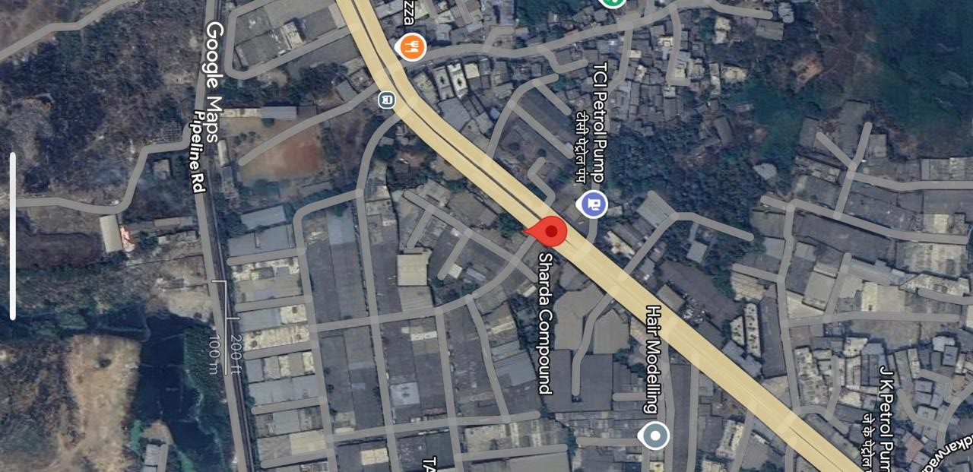
LOCATION MAP-THANE DISTRICT

Slide 10
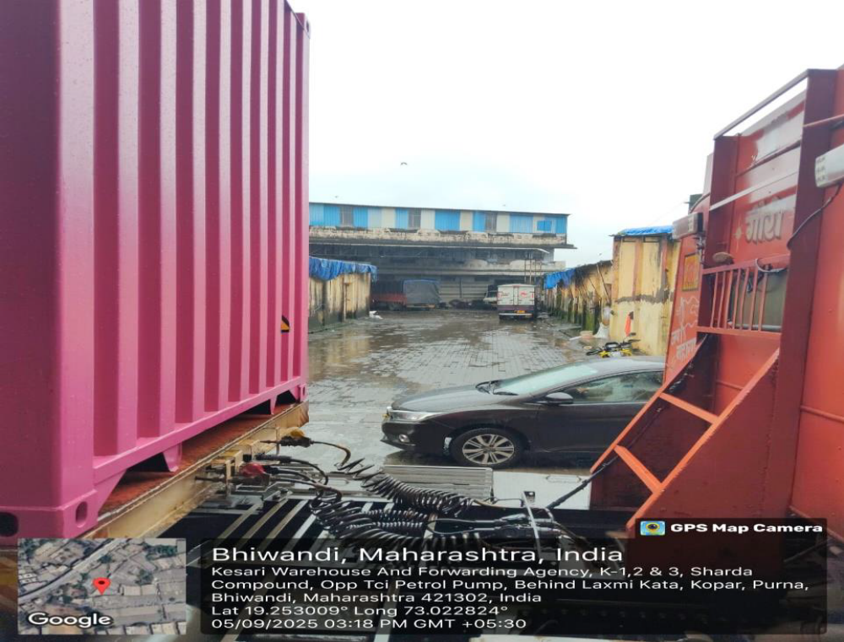
REGISTERED OFFICE IMAGES

Slide 11
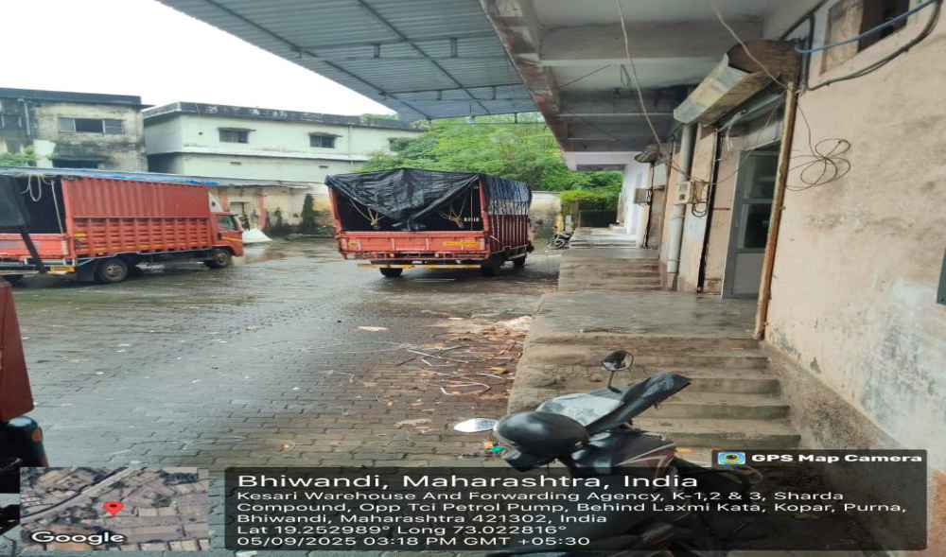
REGISTERED OFFICE IMAGES

Slide 12
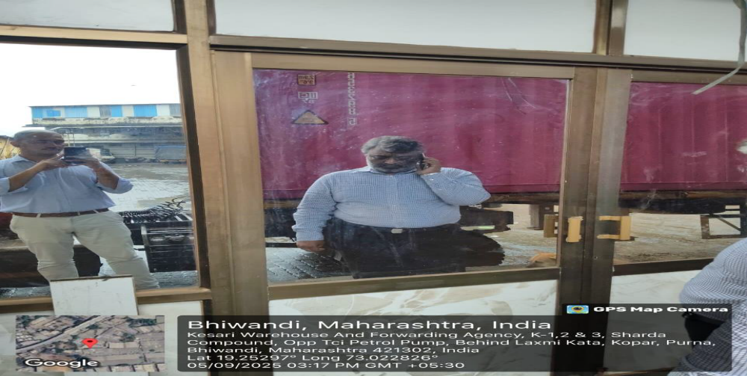
REGISTERED OFFICE IMAGES

Slide 13
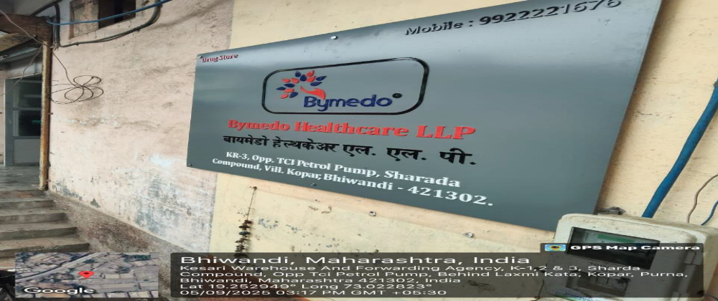
REGISTERED OFFICE IMAGES

Slide 14
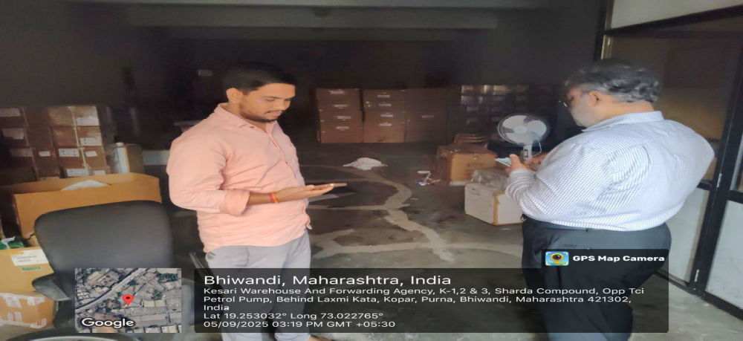
Assets – Stocks Lying at the Premises of the Corporate Debtor - Thane

Slide 15
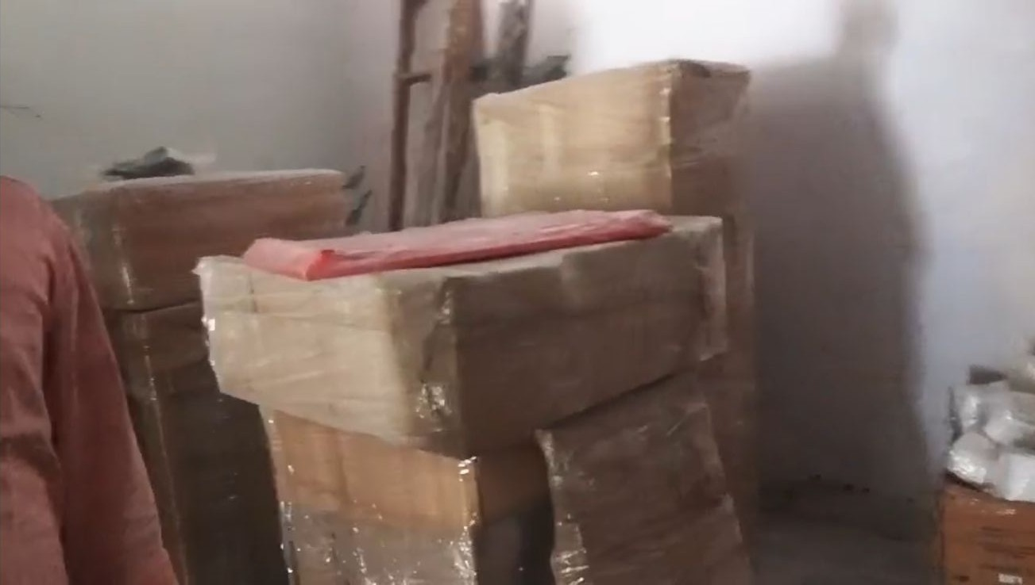
Assets – Stocks Lying at the Premises of the Corporate Debtor - Thane

Slide 16
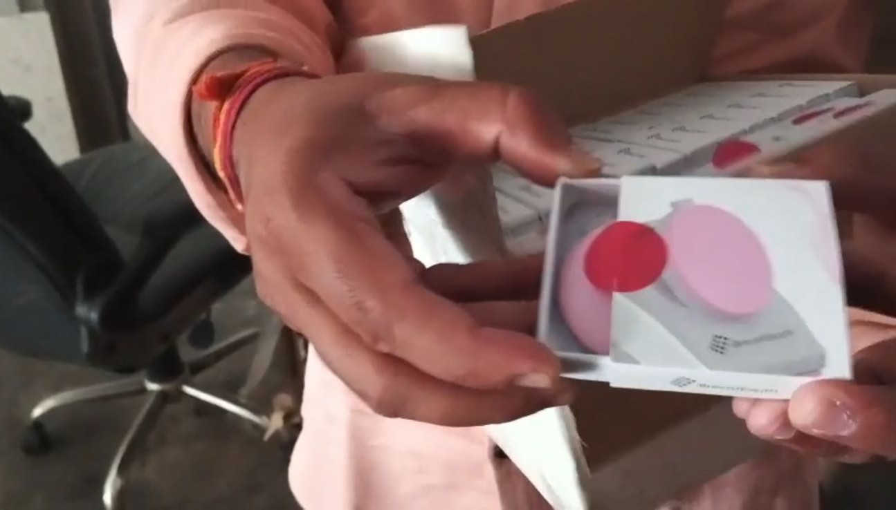
Assets – Stocks Lying at the Premises of the Corporate Debtor - Thane

Slide 17
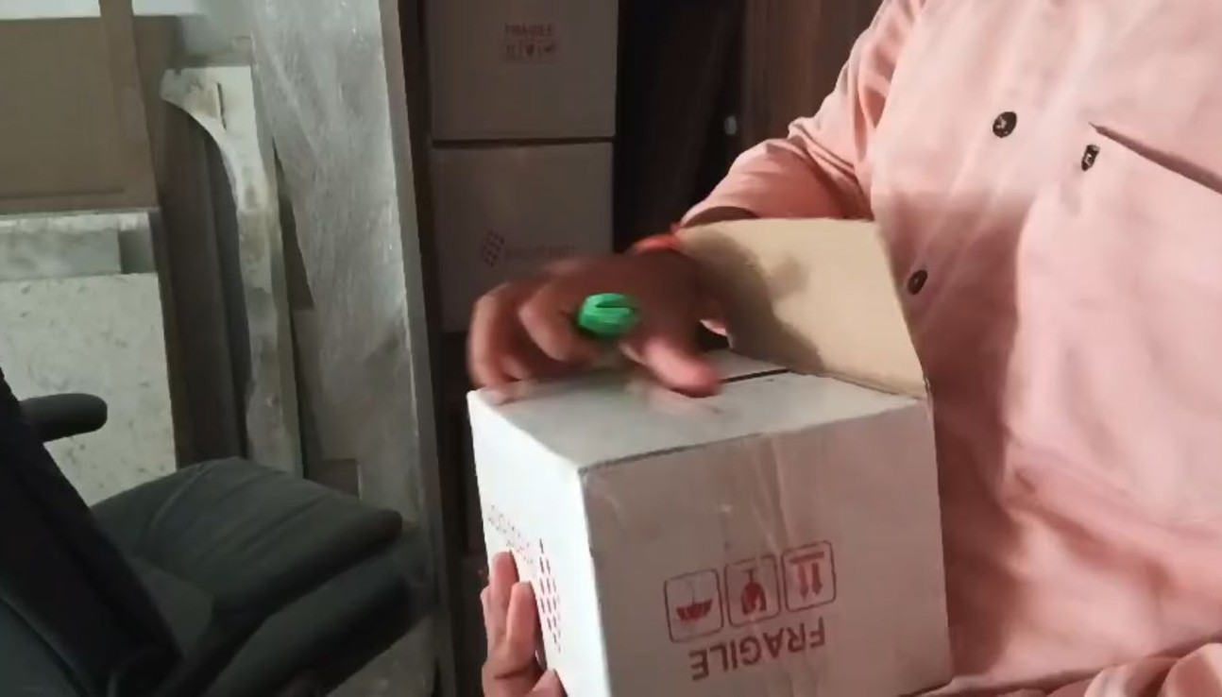
Assets – Stocks Lying at the Premises of the Corporate Debtor - Thane

Slide 18
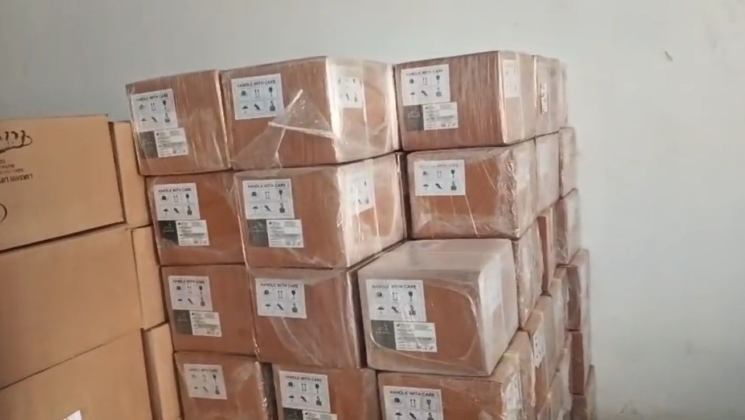
Assets – Stocks Lying at the Premises of the Corporate Debtor - Thane

Slide 19
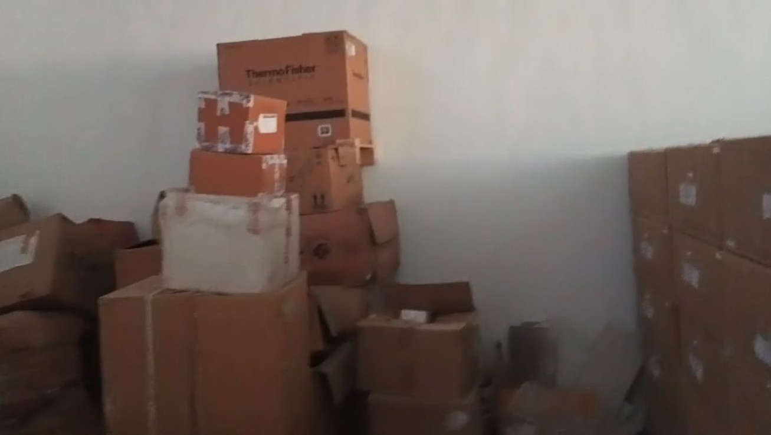
Assets – Stocks Lying at the Premises of the Corporate Debtor - Thane

Slide 20
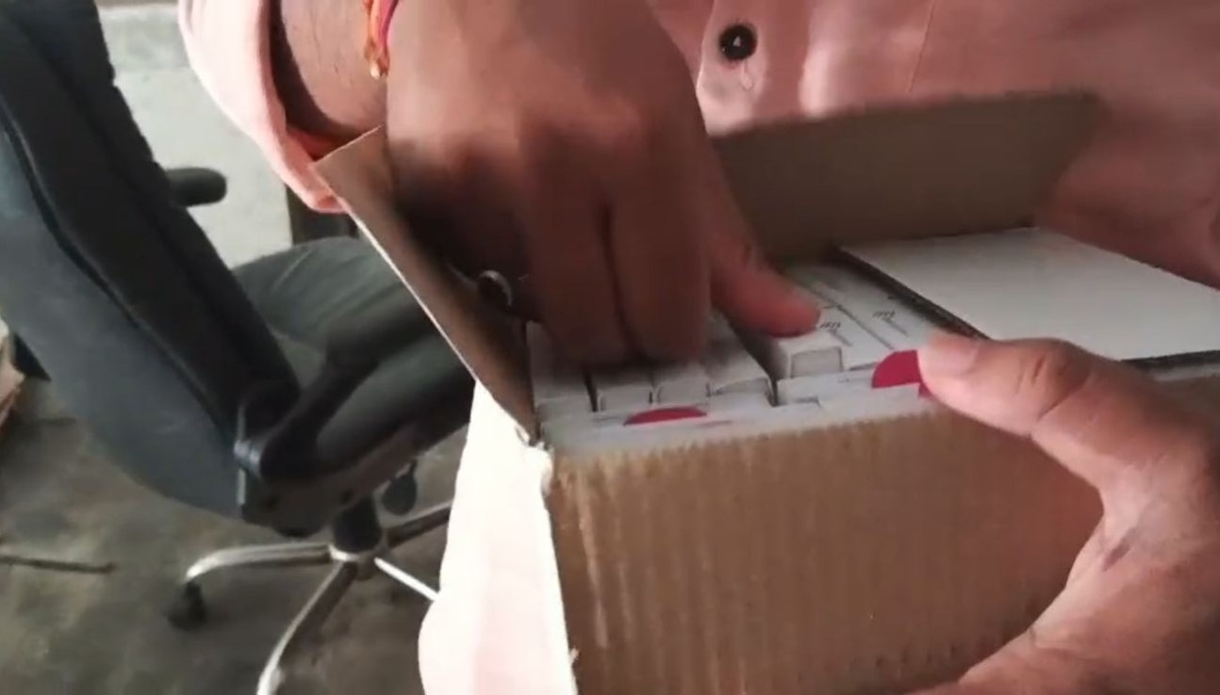
Assets – Stocks Lying at the Premises of the Corporate Debtor - Thane

Slide 21
SUMMARY SNAPSHOT OF FINANCIALS FOR THE PREVIOUS 3 YEARS
Particulars | FY2024-25 (Provisional) (₹)* | FY2023-24 (Audited) (₹)* | FY 2022-23 (Audited) (₹)*
Total Revenue | 10,43,71,529 | 8,15,02,452 | 2,19,17,767
EBITDA | 1,17,13,718 | 56,91,199 | 9,89,127
PAT (Loss) | 22,18,515 | 12,79,066 | 1,24,042
Partner’s Capital | 20,84,937 | 60,67,124 | 32,24,600
*Rupees in hundreds
Notes:
Note : Financials for the FY 2024-25 was not filed since the Books of Accounts were not made available by the SBOP

Slide 22
List of Stakeholders / Creditors
Sr. No. | Name of Creditor | Nature of Claim | Amount Claimed (₹) | Amount of Claim Admitted (₹) | Voting Share
1 | Shriram Finance Limited | Unsecured | 20,65,400.00 | 18,28,905.00 | 5.75%
2 | Tata Capital Limited | Unsecured | 28,83,439.00 | 27,36,638.00 | 8.61%
3 | UE Life Sciences India Private Limited | Unsecured | 2,67,41,918.00 | 2,67,41,918.00 | 84.14%
4 | HDFC Bank Limited | Unsecured | 11,41,536.30 | 4,77,062.68 | 1.50%
 | Total |  | 3,28,32,293.30 | 3,17,84,523.68 | 100%
5 | CGST & Central Excise, Bhiwandi | Operational - Government Dues | 2,71,25,589.00 | 2,71,25,589.00 | N/A
6 | Commissioner Of Income Tax, Circle - 1, Thane | Operational - Government Dues | 4,13,560.00 | 3,47,530.00 | N/A
7 | Boston Ivy Healthcare Solutions Pvt. Ltd. | Operational - Other | 10,92,53,120.00 | 10,63,62,320.00 | N/A
Total Financial Creditors |  |  | 3,28,32,293.30 | 3,17,84,523.68
Total Operational Creditors – Government Dues |  |  | 13,67,92,269.00 | 13,38,35,439.00
Total Claims |  |  | 16,96,24,562.30 | 16,56,19,962.68

Slide 23
Note :
Note: The List of Stakeholders / Creditors as on 10 September 2026 has been prepared by the Liquidator based on the claims verified and admitted in accordance with Regulation 31 of the Insolvency and Bankruptcy Board of India (Liquidation Process) Regulations, 2016, as amended up to 02 June 2026. The list contains the category-wise details of stakeholders, including the amount claimed/admitted and the nature of the claim. The List of Stakeholders has been duly filed with the Hon’ble AA as per Regulation 31 of the IBBI Liquidation Process Regulations and uploaded on the Official Portal of IBBI and Corporate Debtor

Slide 24
Liquidation Sale – Mode of Sale
Under Section 35 of the IBC, 2016 and Regulation 32 of the IBBI (Liquidation Process) Regulations, 2016 (as amended up to 02.06.2026), the Liquidator may sell an asset on a standalone basis, in a slump sale, as a set of assets collectively, or in parcels. An asset under security interest can be sold only after the security interest is relinquished to the liquidation estate.
Assets are ordinarily sold through auction as per Schedule I (Regulation 33). Private sale is permitted only for perishable or fast-deteriorating assets, or with the Adjudicating Authority’s permission, and needs prior approval of the committee with 66% voting share. The consultation committee advises on the manner of sale, pre-bid qualifications and reserve price (Regulation 31A).
The Liquidator shall not sell any asset to a person ineligible under Section 29A of the IBC. Sales to related parties of the Corporate Debtor or of the Liquidator, or to professionals appointed by him, are restricted under Regulation 33.

Slide 25
Key Auction Terms (Schedule I)
Reserve price is the value of the asset determined under Regulation 35 (average of registered valuers’ estimates). If an auction fails, the reserve price may be reduced, with committee approval, by not more than 10% at a time. Earnest money deposit cannot exceed 10% of the reserve price, and no non-refundable participation fee can be charged.
Public notice is issued as per Regulation 12(3) and the auction is to be completed within 35 days of the notice, through an electronic auction platform as notified by the Board. Bidders get access for inspection and due diligence, must deposit EMD at least two days before the auction, and must undertake that they are not ineligible under Section 29A (EMD is forfeited if found ineligible).
The highest bidder’s eligibility is verified within three days and the successful bidder is declared with committee approval (66% voting share). Balance consideration is payable within 90 days or as stated in the auction notice (12% interest after 30 days). Auction dates, reserve price and EMD will be notified by the Liquidator:
Email id : ip.bymedollp@gmail.com.

Slide 26
THANK YOU
Prepared by:
Mr. SANDIP SINGH, LIQUIDATOR
IN THE MATTER OF Bymedo healthcare llp-in liquidation
REgN. No. IBBI/IPA-001/ IP-P-02870/2024-2025/14402
Contact –
Sandip singh : 8981079911
Email id – IP.BYMEDOLLP@GMAIL.COM
Office address : 4 raja raj krishna street, Kolkata 700006

